Slide 1
Pothole dataset
80%
20%
Train dataset
Test dataset
PoFormer
Image resize
Image resize
U-Net
Image Augmentation
E-Net
Evaluation
FCN
LRASPP
AttuNet

Slide 2
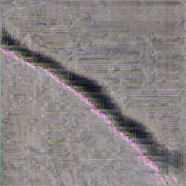
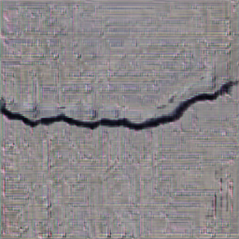
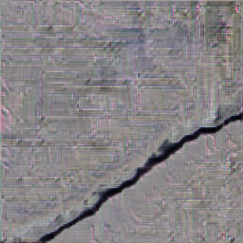
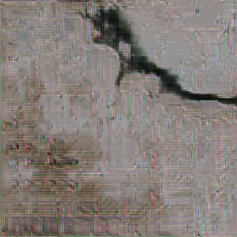
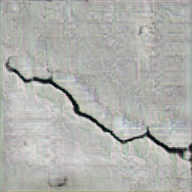
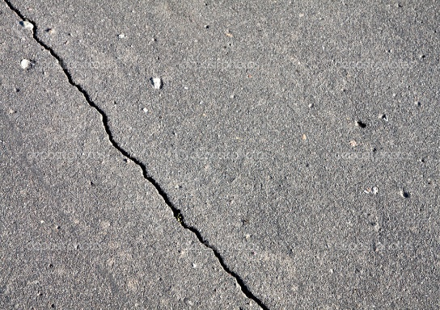
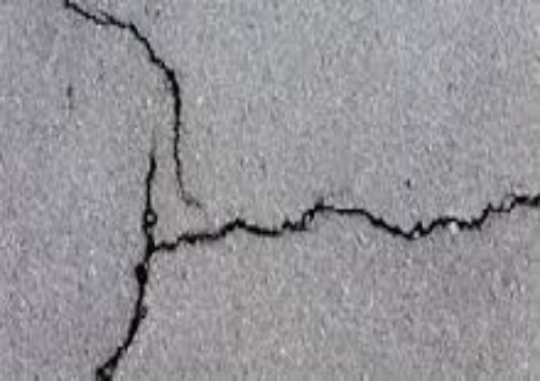
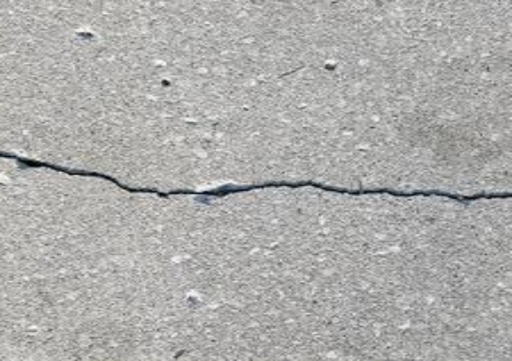
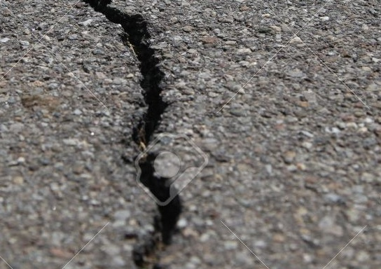
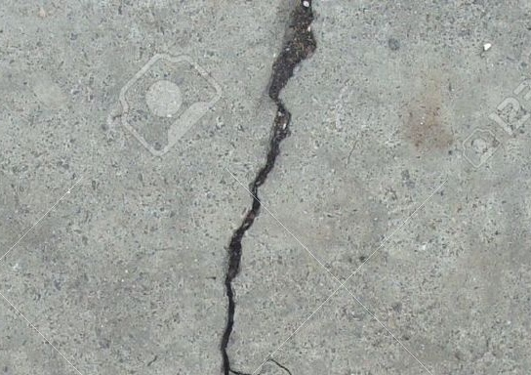
















Random input vector (4096)
Conv2DTranspose (4$×$4)
GaussianNoise (0.2)
ReLU
Fake images
Conv2D (3$×3$)
G-Block
G-Block(4$×$4)
LeakyReLU (0.2)
Conv2D (4$×$4)
G-Block(4$×$4)
Dropout (0.25)
BatchNormalization (0.7)
G-Block(3$×3$)
AveragePooling2D
ReLU
G-Block(3$×3$)
D-Block(3$×3$)
UpSampling2D
G-Block(3$×3$)
D-Block(3$×3$)
Conv2D(3$×3$)
D-Block(3$×3$)
D-Block
ReLU
D-Block(3$×3$)
Conv2D (3$×3$)
UpSampling2D
D-Block(3$×3$)
BatchNormalization (0.7)
Conv2D (3$×3$)
Flatten
LeakyReLU (0.2)
Sigmoid
Dense(128)
Dropout (0.25)
Real images
LeakyReLU (0.2)
AveragePooling2D
Dense(1)
Real/fake
Update model
Update model

Slide 3





decoder2D
Conv2D (3$×3$)
BatchNorm2D
ReLU
self.decoder_1 = nn.Sequential(
nn.Conv2d(in_channels, features[0], 3, padding=1),
nn.BatchNorm2d(features[0]),
nn.ReLU(inplace=True),
nn.Upsample(scale_factor=2, mode="bilinear", align_corners=True)
)
self.decoder_2 = nn.Sequential(
nn.Conv2d(features[0], features[1], 3, padding=1),
nn.BatchNorm2d(features[1]),
nn.ReLU(inplace=True),
nn.Upsample(scale_factor=2, mode="bilinear", align_corners=True)
)
self.decoder_3 = nn.Sequential(
nn.Conv2d(features[1], features[2], 3, padding=1),
nn.BatchNorm2d(features[2]),
nn.ReLU(inplace=True),
nn.Upsample(scale_factor=2, mode="bilinear", align_corners=True)
)
self.decoder_4 = nn.Sequential(
nn.Conv2d(features[2], features[3], 3, padding=1),
nn.BatchNorm2d(features[3]),
nn.ReLU(inplace=True),
nn.Upsample(scale_factor=2, mode="bilinear", align_corners=True)
)
self.final_out = nn.Conv2d(features[-1], out_channels, 3, padding=1)
Upsampling
Conv2D (3$×3$)
BatchNorm2D
ReLU
Upsampling
Conv2D (3$×3$)
BatchNorm2D
ReLU
Upsampling
Conv2D (3$×3$)
BatchNorm2D
ReLU
Upsampling
Conv2D (3$×3$)

Slide 4




decoder2D
Conv2D (3$×3$)
BatchNorm2D
ReLU
UpSample
Conv2D (3$×3$)
BatchNorm2D
ReLU
UpSample
Conv2D (3$×3$)
BatchNorm2D
LeakyReLU
UpSample
Conv2D (3$×3$)
BatchNorm2D
LeakyReLU
UpSample
LeakyReLU

Slide 5
Linear
Eecoder2D
InputDense2D
ACT2FN
rearrange
TranslayerNorm
TransModel2d
Embedding
Final dense
TransEmbeddings
TranslayerNorm
rearrange
droupout
transselfattention
transselfoutput
Transattention
TransEncoder
Linear
Translayer
transintermediate
ACT2FN
Transoutput
Linear
droupout
TranslayerNorm

Slide 6



Linear
Input
GELU
TranslayerNorm
Linear
Linear
Linear
Embedding
TranslayerNorm
$$×$$
Drop out
Attention
SoftMax
Drop out
Linear
Drop out
$$×$$
TranslayerNorm
Linear
Output
GELU
Linear
$$×$$
: Matrix multiple
Drop out
TranslayerNorm

Slide 7







(b)
(a)
Input
Conv2D (3$×3$)
BatchNorm2D
Linear
Linear
Linear
RELU
Linear
UpSample
$$×$$
GELU
Conv2D (3$×3$)
TranslayerNorm
BatchNorm2D
SoftMax
Embedding
RELU
Drop out
TranslayerNorm
UpSample
$$×$$
Drop out
Conv2D (3$×3$)
Self-Attention
BatchNorm2D
Output
LeakyReLU
Linear
UpSample
Drop out
Conv2D (3$×3$)
TranslayerNorm
BatchNorm2D
Linear
LeakyReLU
$$×$$
: Matrix multiple
GELU
UpSample
: Encoder
Linear
LeakyReLU
: Decoder
Drop out
TranslayerNorm

Slide 8
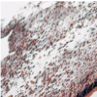
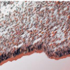




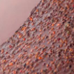
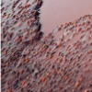








(a)
(b)
(c)
Linear
Conv2D (3$×3$)
…
GELU
BatchNorm2D
TranslayerNorm
RELU
Patch embedding
Embedding
UpSample
Position embedding
0
1
2
…
n
TranslayerNorm
Conv2D (3$×3$)
Drop out
BatchNorm2D
$$N×$$
Transformer Layer
Multi-head
Attention
RELU
Decoder
UpSample
$$+$$
Conv2D (3$×3$)
Linear
BatchNorm2D
Drop out
LeakyReLU
TranslayerNorm
UpSample
Linear
Conv2D (3$×3$)
GELU
BatchNorm2D
Linear
LeakyReLU
Drop out
UpSample
TranslayerNorm
LeakyReLU
$$+$$

Slide 9


(a)
(b)
(c)
…
Linear
Conv2D (3$×3$)
Patch
F
GELU
BatchNorm2D
P
0
1
2
…
n
TranslayerNorm
RELU
Embedding
UpSample
…
…
$$N×$$
Transformer Layer
TranslayerNorm
Conv2D (3$×3$)
Drop out
BatchNorm2D
Decoder
RELU
Multi-head
Attention
UpSample
$$+$$
Conv2D (3$×3$)
Linear
BatchNorm2D
Drop out
LeakyReLU
TranslayerNorm
UpSample
P
Position embedding
F
Flat encoding
Linear
Conv2D (3$×3$)
GELU
BatchNorm2D
(d)
The i^{th} patch (16$×$16)
P
Linear
LeakyReLU
1
0
…
3
F
Drop out
0
5
…
2
…
…
UpSample
16
i
1
0
3
0
5
1
TranslayerNorm
…
…
…
…
LeakyReLU
…
$$+$$
2
1
1
Length=256
16

Slide 10
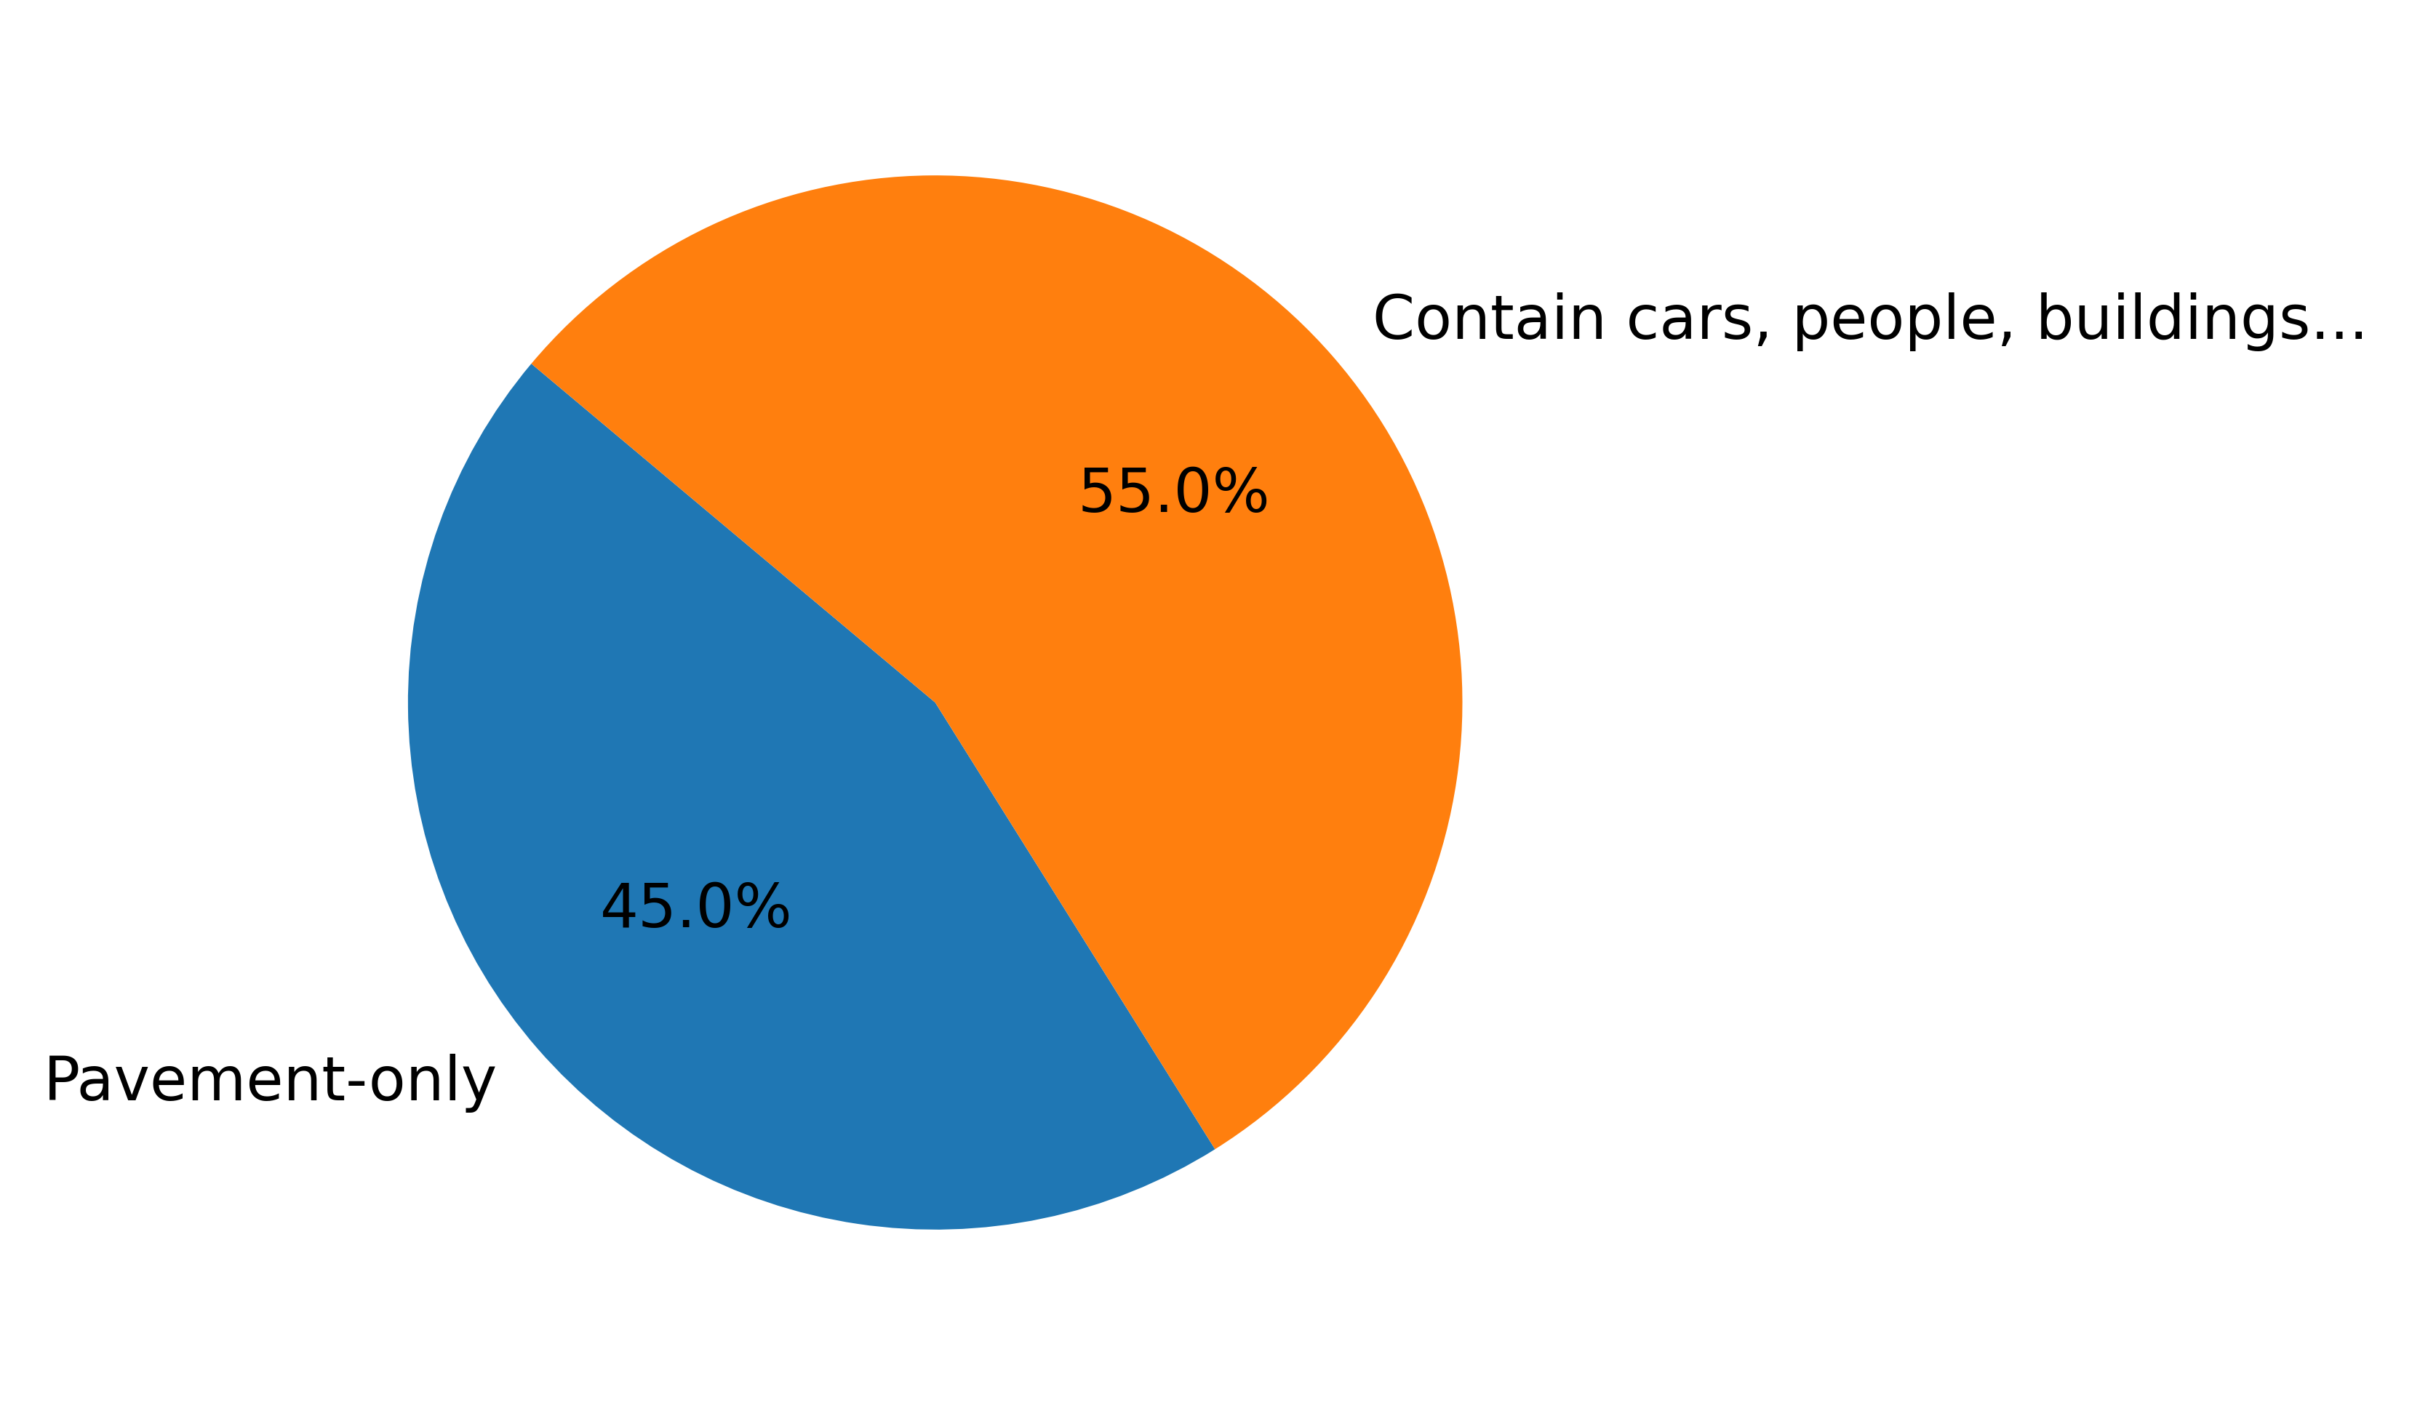
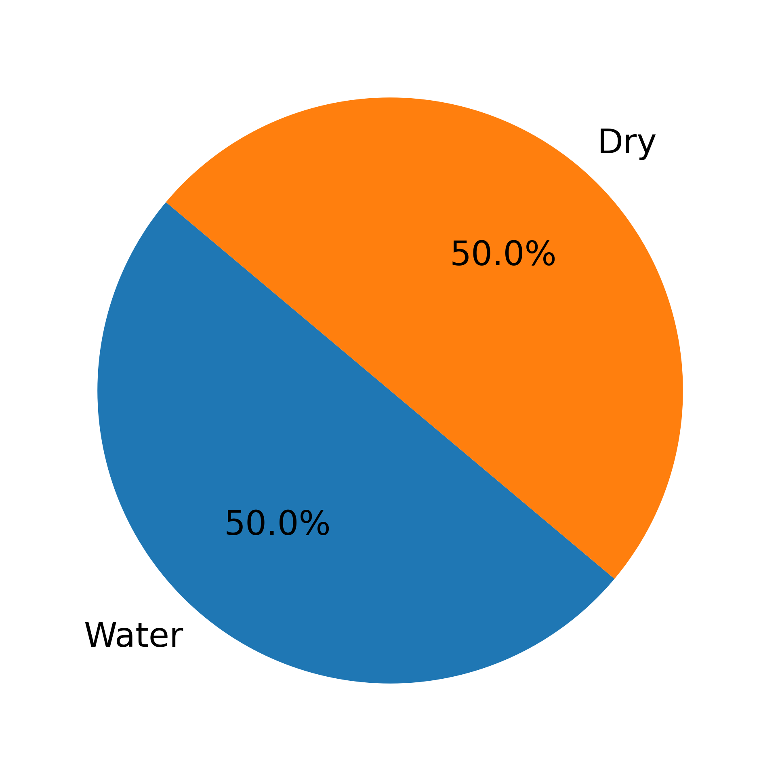
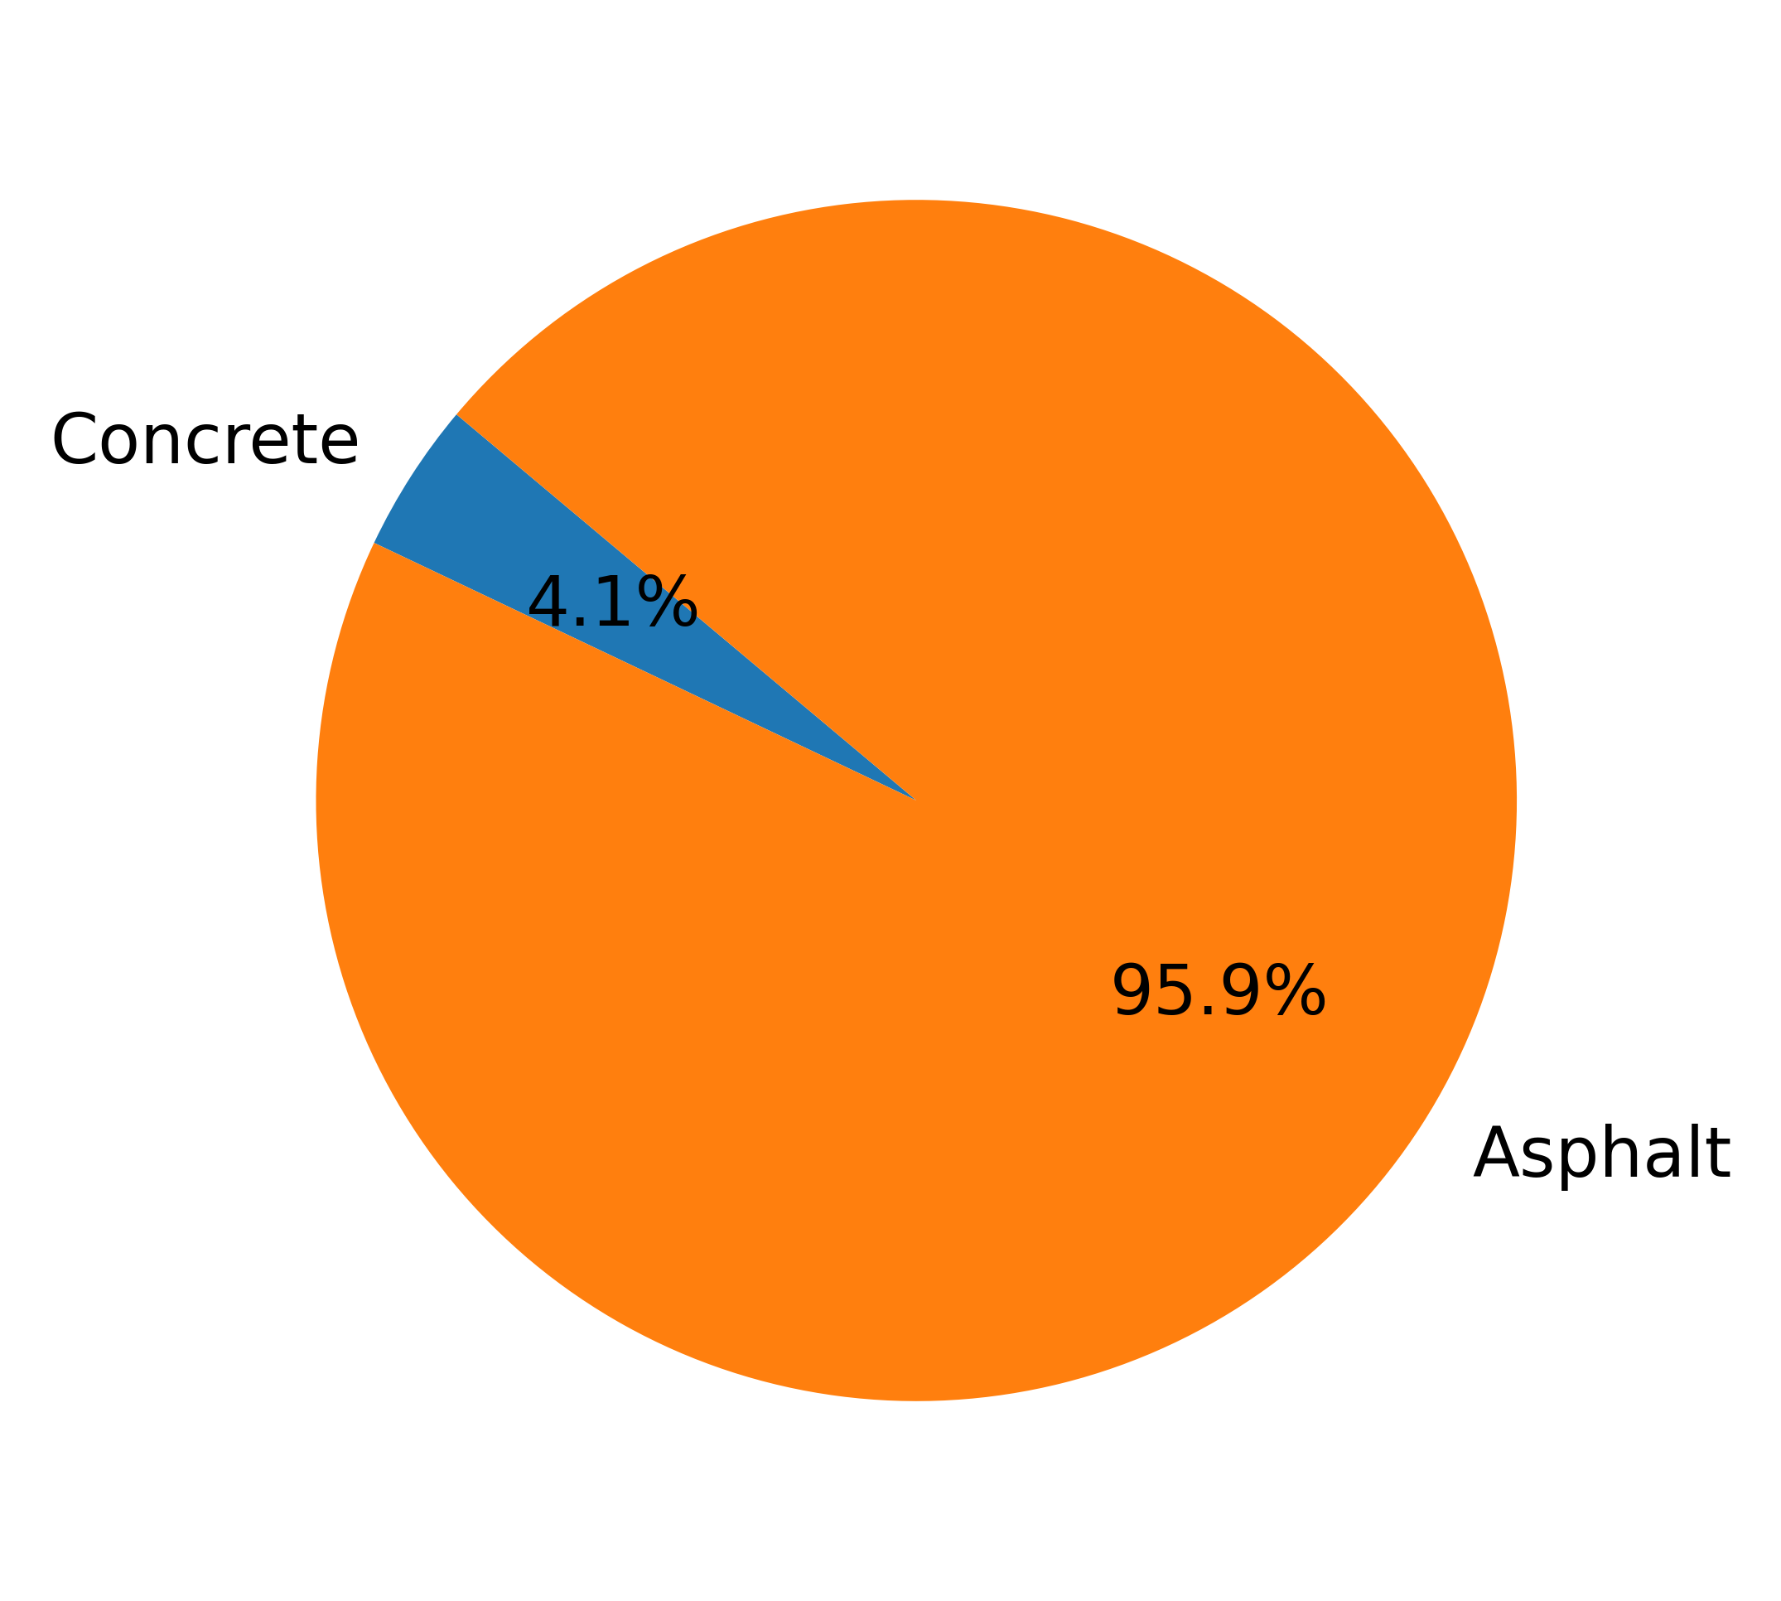
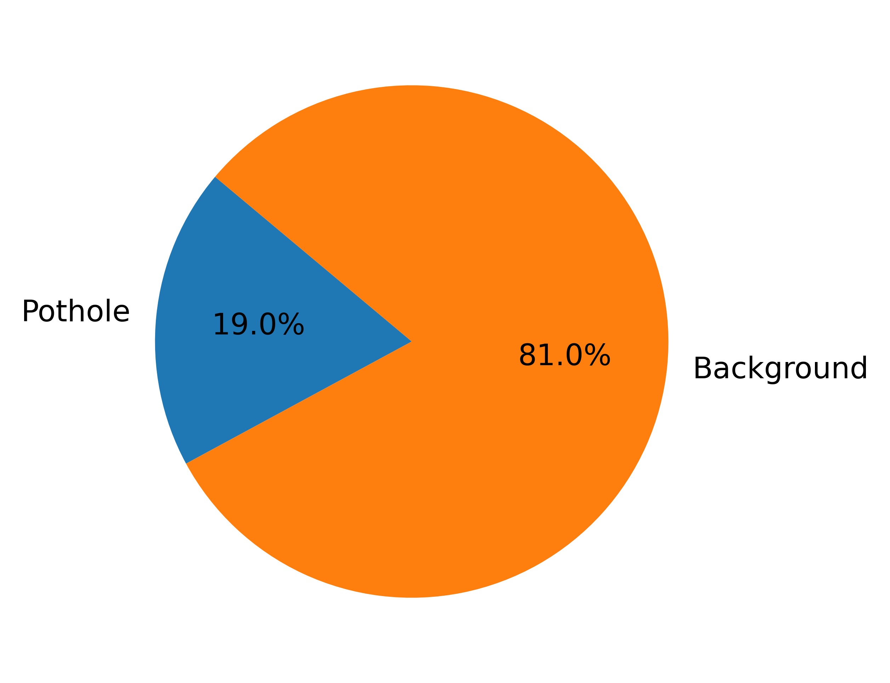
(a)
(b)
(c)
(d)

Slide 11
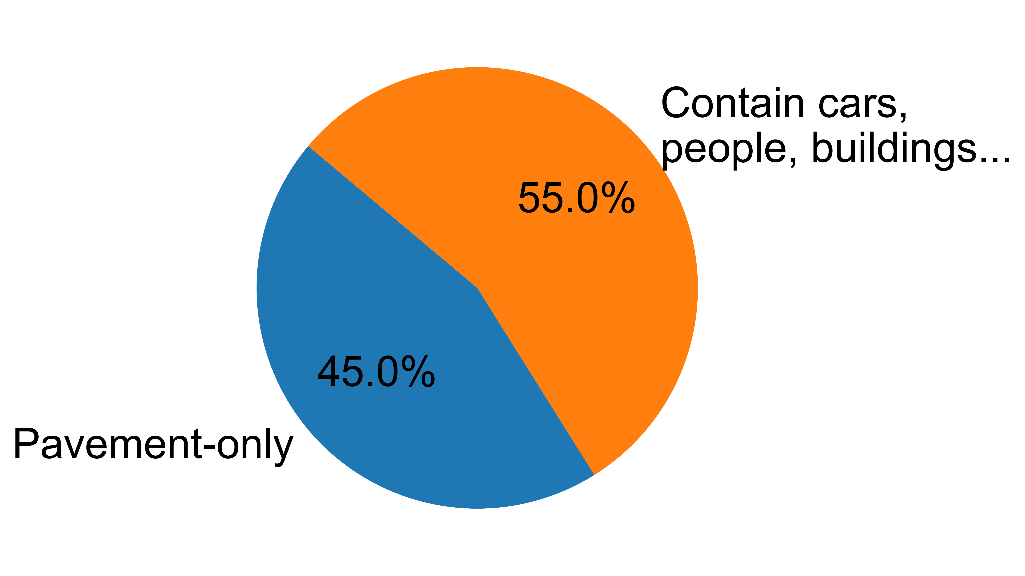
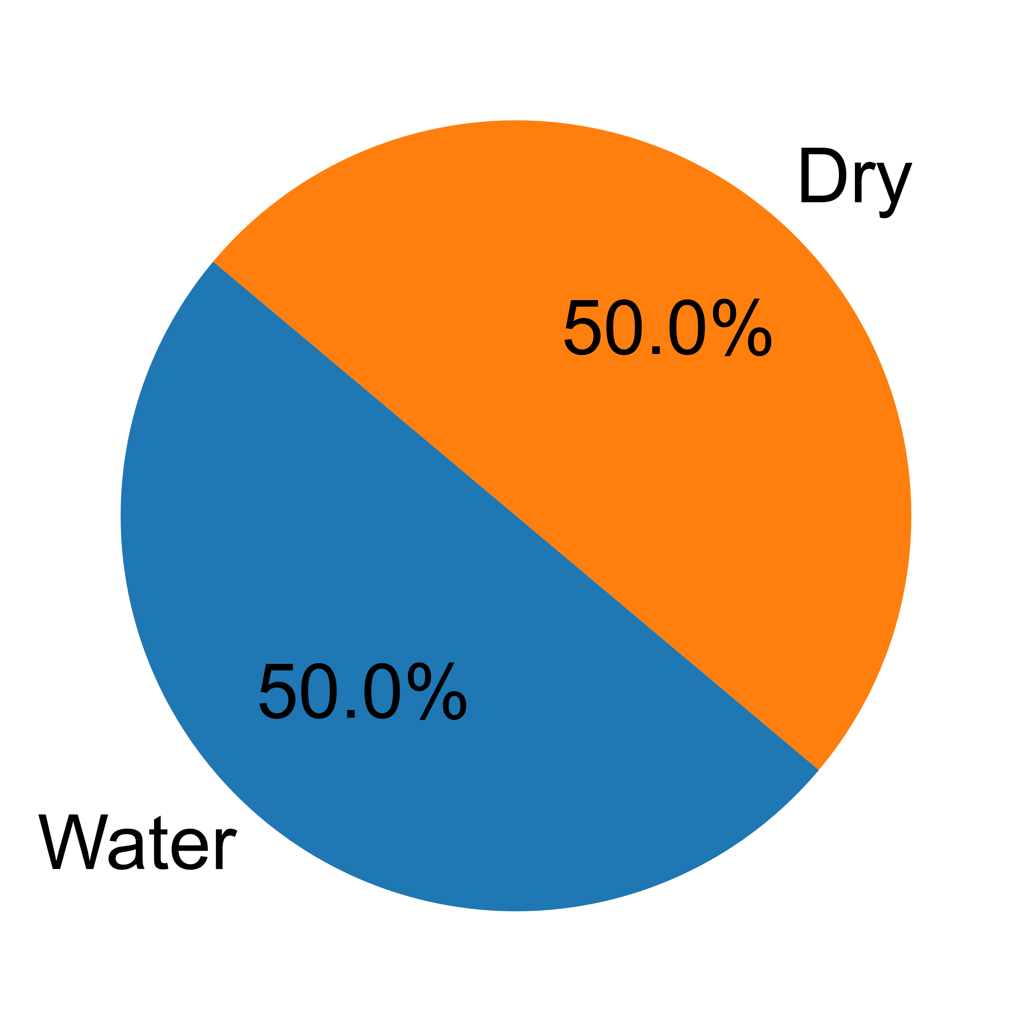
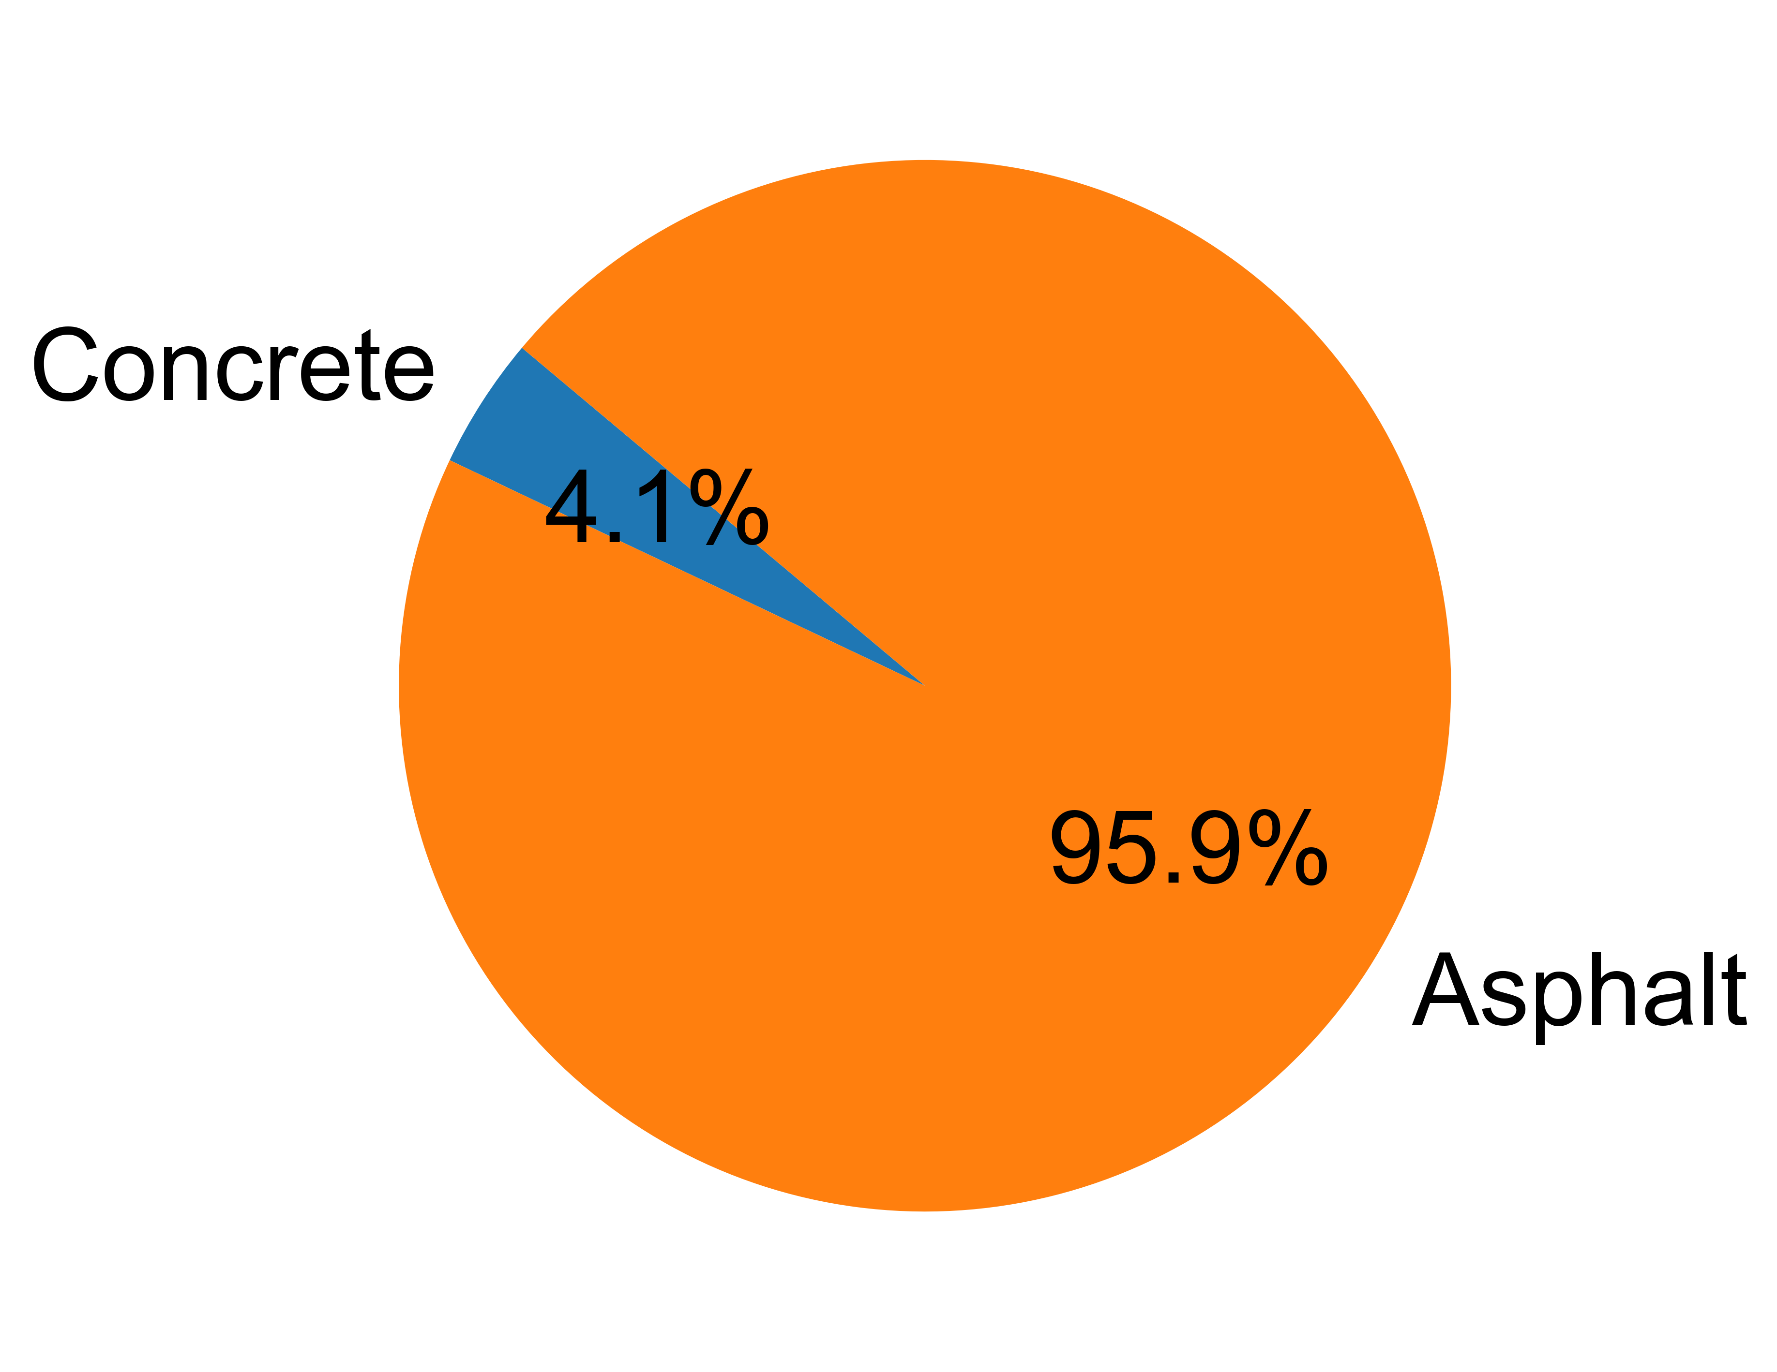
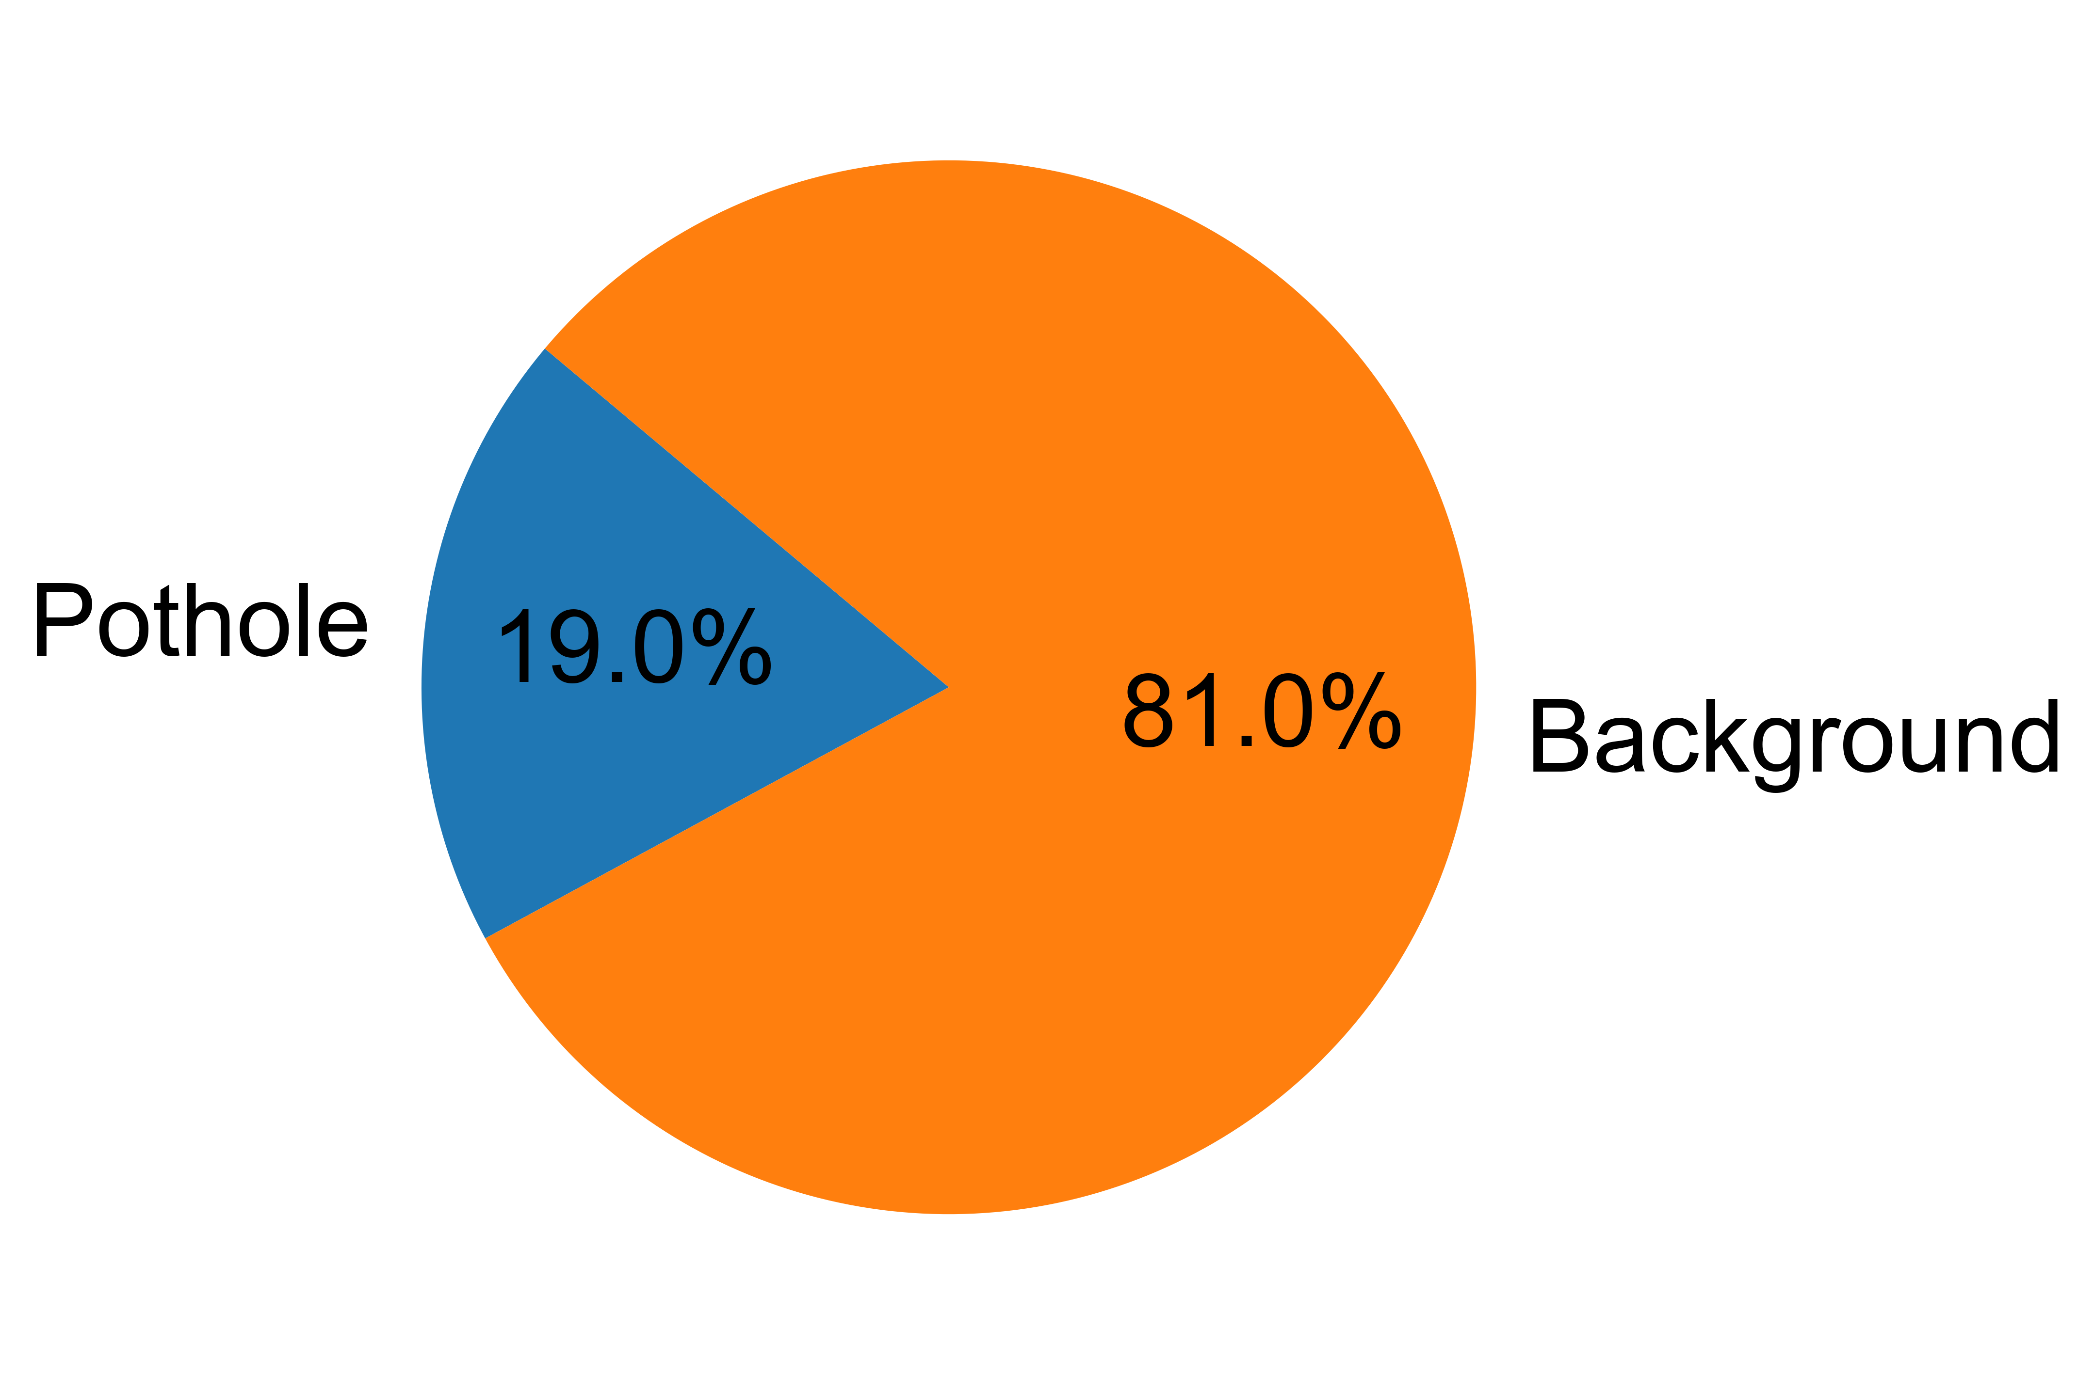
(a)
(b)
(c)
(d)

